Slide 1
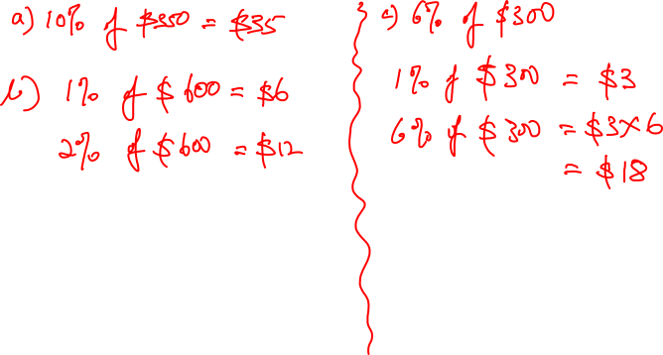
5 minutes quiz
1. Find the following amounts:
a) 10% of $350 b) 2% of $600 c) 6% of $300

Slide 2
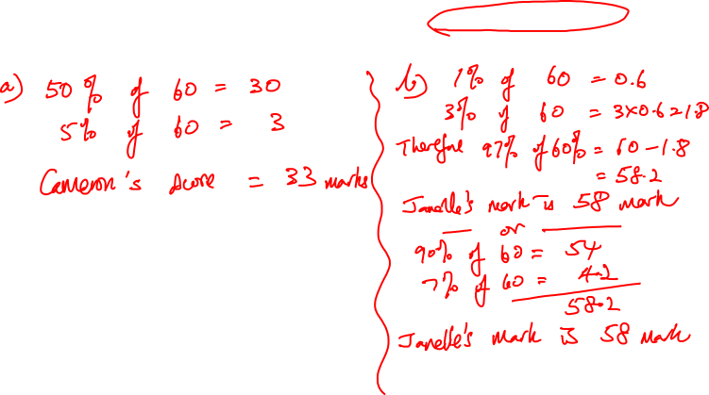
2. The following students gained these percentages on a Year 11 test. If the test was out of 60 marks, calculate each student’s score to the nearest whole number:
a) Cameron 55% b) Janelle 97%

Slide 3
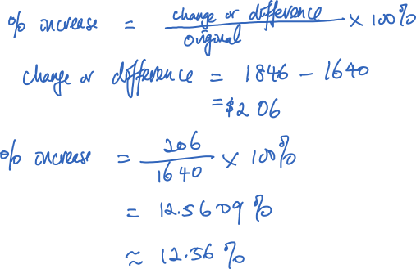
3. The price of a commodity increases from $1 640 per tonne to $1 846 per tonne. Express the increase as a percentage increase.

Slide 4
Consumer Arithmetic - Percentages

Slide 5
Application of percentages
Discount
Inflation
Profit and loss
GST
Commission
Taxes
Interest – simple and compound
Others

Slide 6

Discount
Reduction of price
Reasons:
Sale
Bulk buy
Damaged goods
Cash purchases
Customer loyalty
Usually express in % of the original price
Discount = original price * % discount
Notes:
http://tweakyourbiz.com/marketing/2015/04/14/how-discounts-and-sales-deals-help-ecommerce-boom-globally/

Slide 7
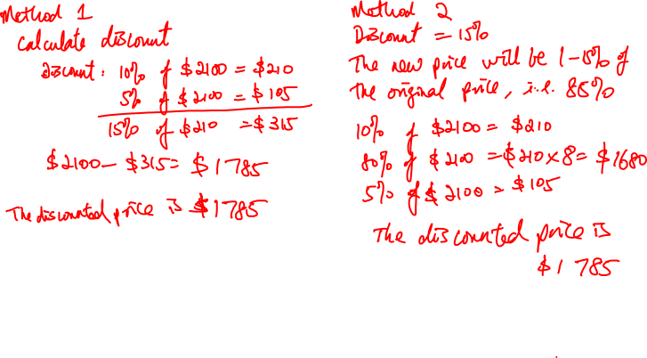
Company X is giving a discount of 15% for all their computers. What is the discounted price for a computer with a price tag of $2 100.

Slide 8
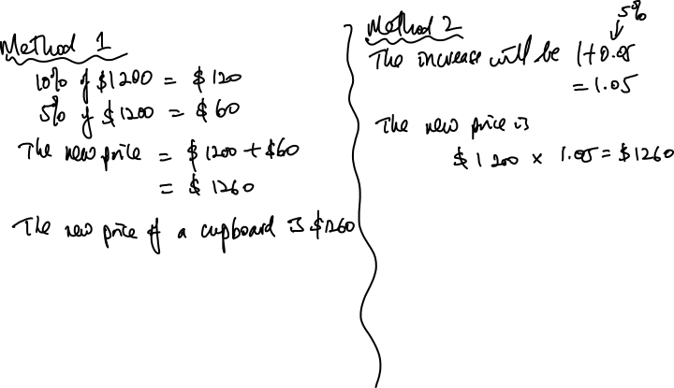
Mr Smith increases the price of the furniture he sells by 5%. If the original price of a cupboard is $1 200, what is the new price?

Slide 9
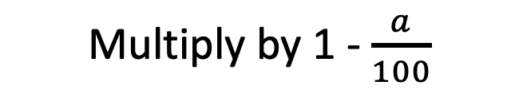
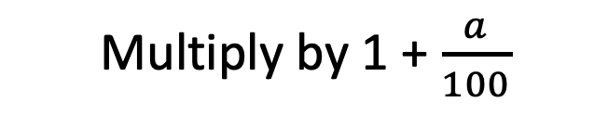
Final Amount
Multiply by 1 + $\frac{a}{100}$
Increase by a%
Original Amount, X
Decrease by a%
Final Amount
Multiply by 1 - $\frac{a}{100}$

Slide 10
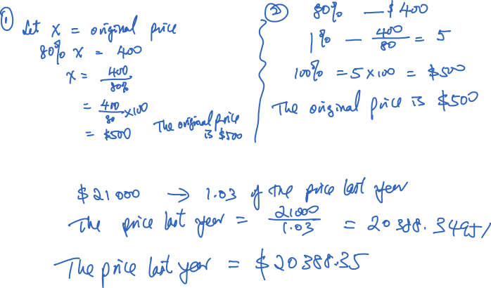
After discount of 20%, the price of a phone is $400. What is the original price?
After inflation (3% p.a), the price of a car is $21 000. What was the price last year?

Slide 11


Amount increased by a%
Divide by 1 + $\frac{a}{100}$
Original Amount, X
Divide by 1 - $\frac{a}{100}$
Amount decreased by a%

Slide 12
Inflation
Rise in the price of goods over a period of time
Usually in annual percentage rate
Different countries have different inflation rates
Link to purchasing power
Notes:
http://thestockyfox.com/2016/02/2015-was-an-awesomely-tame-year-for-inflation/
http://en.tradimo.com/tradipedia/inflation-rate/

Slide 13
Notes:
http://www.evalesco.com.au/cash-terrible-long-term-investment/

Slide 14
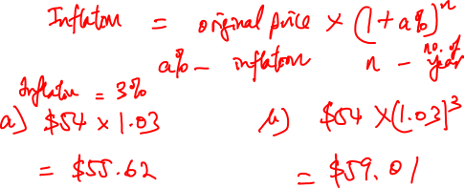
Assume that the annual rate of inflation is 3%, and the current price of a particular item is $54. What is the price of that item in a) one year; b) 3 years?

Slide 15
Goods and Services Tax (GST)
Goods and services tax (GST) is a broad-based tax of 10% on most goods, services and other items sold or consumed in Australia. (Australian Tax Office)
Rate – 10% in Australia
Different in other countries
Called Value Added Tax (VAT) in some other countries
Notes:
http://www.gstmalaysia.co/
https://www.ato.gov.au/Business/GST/

Slide 16

Calculating Price including GST
Price including GST = original price + GST
= original price + (original price * 10%)
= original price *(1 + 10%)
= 1.1 * original price
Calculating GST
GST = $\frac{\text{Price} \text{including} \text{GST}}{11}$

Slide 17
Profit and loss
Profit – Selling something above the price we paid for
Loss – Selling something below the price we paid for
Price we paid for the item = $x
Price we sold of the item = $y
Difference in price = $y - $x
If $y - $x > 0, we made a profit
If $y - $x < 0, we made a loss
If $y - $x = 0, we broke even
Price we paid, $x

Slide 18
Percentage profit/loss
Percentage profit = $\frac{profit made when you sell the item}{amount you paid for the item}$ * 100%
Percentage loss = $\frac{loss made when you sell the item}{amount you paid for the item}$ * 100%

